Slide 1
High Protein, Lower Sodium Healthcare Recipes
May 12
Egg Protein for all Dayparts!
2020

Slide 2
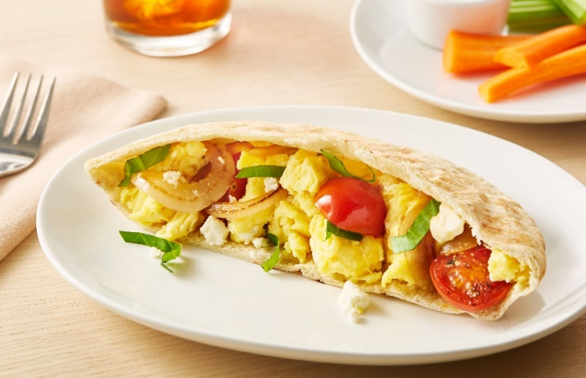
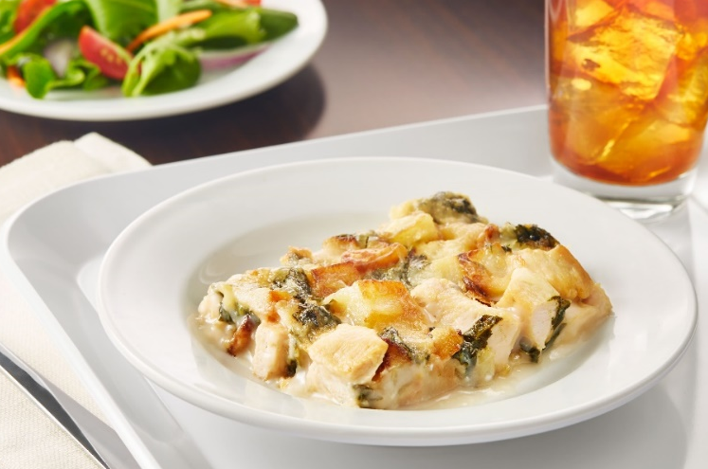
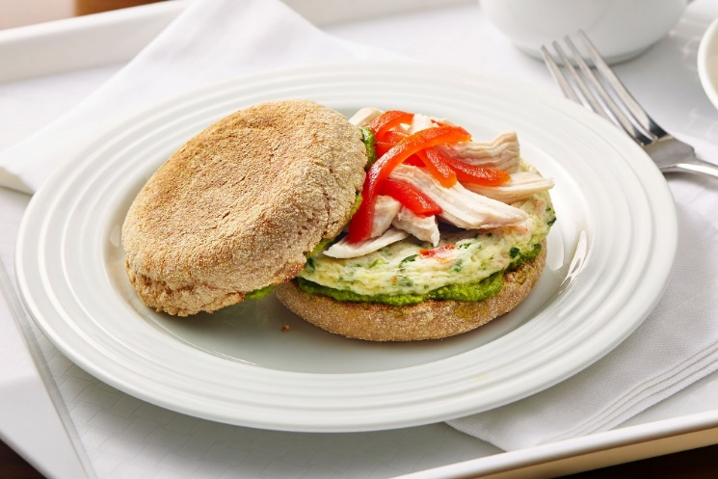
High Protein and Lower Sodium Recipes
What’s inside?
Six recipes featuring egg and potato products with 10 grams or more of protein per serving and limited sodium.
Concepts include the breakfast, lunch and dinner dayparts, allowing you to use eggs as a protein source throughout the day.
The recipes are simple to execute and designed specifically for healthcare production.
All concepts use ingredients that are typically found in a healthcare foodservice operation.
Each recipe details the ingredients, preparation method and has a nutritional analysis.

Slide 3





Product Solutions for Healthcare Operator Challenges Egg and Potato
Food safety &
Regulatory
System Consistency of Products
Labor
FOOD COSTS
FLAVOR
Pasteurization reduces the risk of foodborne pathogens and cross contamination
Pasteurized products are compliant with regulations
Consistent products ensure nutrition and preparation are the same, every day
National distribution presence and distributor product offerings bring assurance of supply
Value added egg and potato products save time in the kitchen
A limited skill set is needed to prepare value added egg and potato products
Eggs are an affordable source of high quality protein
Our egg and potatoes allow you to easily manage your food budgets
Potatoes are a will liked and affordable option
Eggs and potatoes serve as a base for adding unique flavor profiles for varying ages and palates

Slide 4
Egg Nutrition Snapshot
Egg proteins are easily digestible and contain all of the essential amino acids.
One egg has only 70 calories but 6 grams of high-quality protein, 5 grams of fat, and 1.6 grams of saturated fat, along with iron, vitamins, minerals, and carotenoids.
Eggs are the least expensive source of high-quality protein.
Value added eggs provide enhanced food safety.
Egg protein has a very high biological value, a measure of the proportion of absorbed protein from a food that becomes incorporated into your body.
Biological Values of Protein
On a scale, with 100 representing top efficiency, these are the biological values of proteins in several foods.
Whole Egg | 93.7
Milk | 84.5
Fish | 76.0
Beef | 74.3
Soybean | 72.8
Rice, Polished | 64.0
Wheat, Whole | 64.0
Corn | 60.0
Beans, Dry | 58.0
Source: https://www.incredibleegg.org/egg-nutrition/egg-facts/
Source: Food and Agriculture Organization of the United Nations

Slide 5
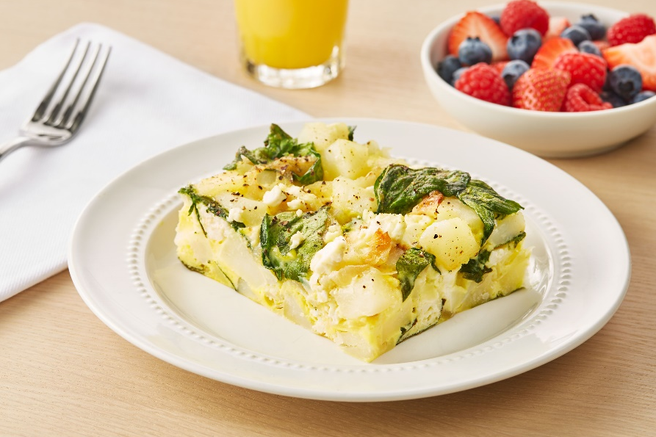
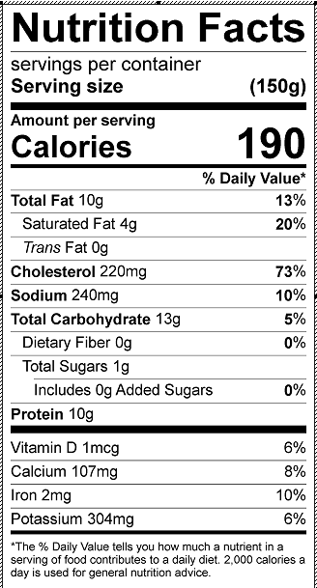
Caramelized Onion, Potato and Feta Frittata
An easy to prepare, better for you frittata featuring onions, greens, egg and potatoes.
Featuring: Simply Potatoes® Small Diced Potatoes, 20169-15110-00
Featuring: Papetti’s® Liquid Whole Eggs, 46025-91200-00
Servings: 24
Ingredients
Greens your choice (Kale, Arugula, Spinach) | 6 Cups
Onion sliced | 3 Cups
Olive oil | ¼ cup
Simply Potatoes® Small Diced Potatoes, 20169-15110-00 | 3 lbs.
Feta Crumbled | 2 Cups
Papetti’s® Liquid Whole Eggs, 46025-91200-00 | 13 lbs.
Pepper | To taste
Directions In large pan over medium heat sauté onions in oil until browned In large bowl mix greens, onions, potatoes cheese and seasoning Equally distribute potato mixture in to ½ 2-inch hotel pans that has been sprayed with oil Pour eggs over potato mixture in each pan until ¼ inch to the top, stir so all vegetables and potatoes are covered by egg Bake at 350° F uncovered until set and internal temperature reaches 155° F Remove from oven and let set for 15 min before cutting

Slide 6
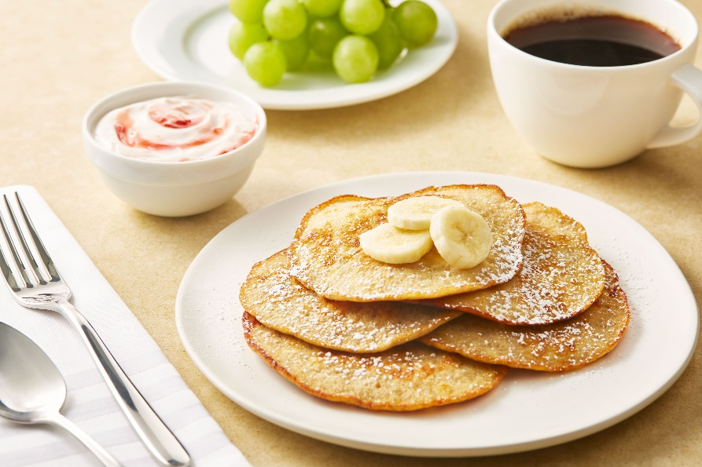
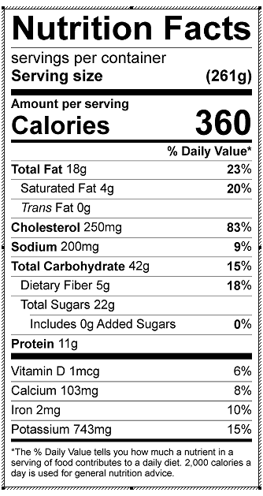
Silver Dollar Protein Banana Pancakes
A healthful spin on a breakfast favorite. These banana pancakes are high in protein and delicious!
Featuring: Papetti’s® Liquid Whole Eggs, 46025-91200-00
Servings: 24/25 Pancakes, Portion Size 4-5 Pancakes
Ingredients
Peeled Banana | 32 oz. (approx. 3)
Papetti’s® Liquid Whole Eggs, 46025-91200-00 | 12 oz.
Olive oil | ¼ cup
Baking Powder | 1 tsp.
Directions Mash bananas in a large mixing bowl or mixer. Add eggs and oil and mix on medium speed until frothy, While mixing, slowly add baking powder and mix thoroughly. Heat skillet on medium-high and add about 2-3 tablespoons of batter (use a small ladle or 1/4 cup measuring cup filled a little more than halfway) The batter should sizzle immediately. Flip each pancake gently after 1 minute and cook for 1 more minute. Remove carefully and serve hot

Slide 7
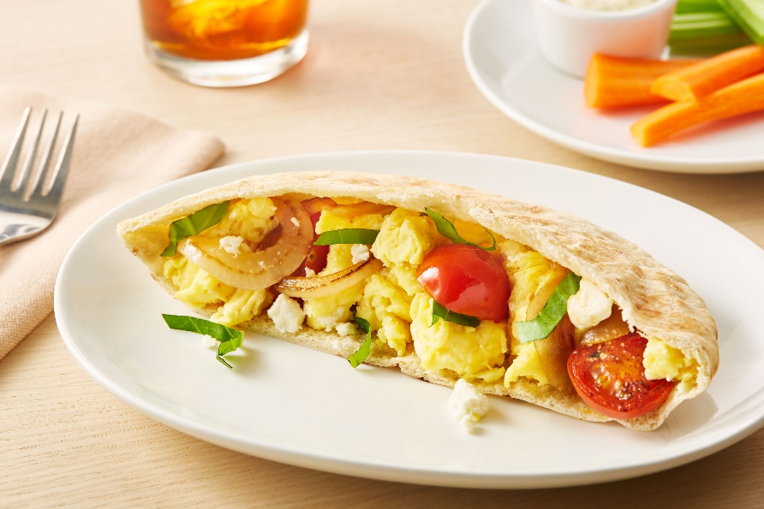
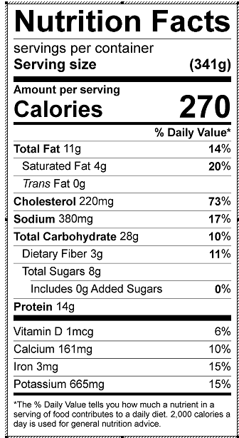
Egg and Cheese Pita with Onion and Basil
A high flavor pita sandwich that can be served for breakfast or lunch.
Featuring: Papetti’s® Liquid Whole Eggs, 46025-91200-00
Servings: 24
Ingredients
Pita Pocket, warm cut in half | 24
Olive Oil | 2 Tbs.
Yellow Onion thinly sliced | 6 cups
Cherry Tomatoes cut in half | 1 lb.
Fresh Basil chopped | 1 & 1/2 Cups
Papetti’s® Liquid Whole Eggs, 46025-91200-00 | 84 oz.
Feta Cheese, Crumbled | 12 oz.
Black Pepper | 1 tsp
Directions Heat olive oil in a skillet over medium heat. Add onion and cook, stirring occasionally, until soft ( about 3 minutes). Add cherry tomatoes and basil, and season with pepper. Cook, stirring occasionally, until tomatoes are soft (about 5 minutes). Remove from heat and hold warm. Heat a nonstick skillet over low heat. Add eggs to nonstick skillet and cook, stirring constantly until egg is set but still runny (about 1 minute). Add cheese and remove from heat, continuing to stir so cheese softens and starts to melt For 1 Portion: Place 3 oz. tomato mixture in each pita half and top with each with 2 oz. egg and cheese mixture

Slide 8
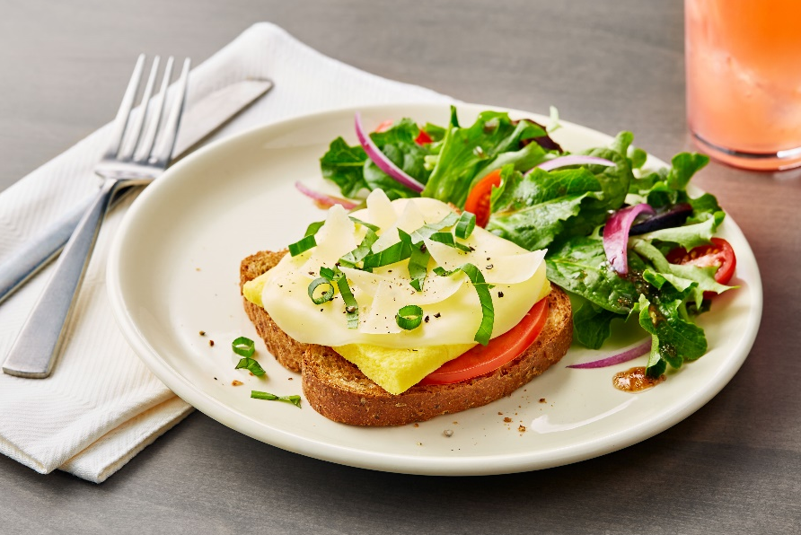
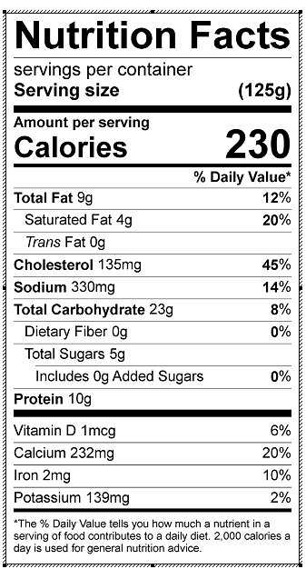
Grilled Cheese and Egg Melt
A hearty open face sandwich with familiar and comforting flavors. This recipe has been developed to have high protein and lower sodium levels.
Featuring: Papetti’s® Square Patty, 46025-61688-00
Servings: 24
Ingredients
Cooking Spray
Whole grain bread slices | 24
Provolone Cheese thin slice | 24
Papetti’s® Square Egg Patty, 46025-61688-00 | 24
Tomatoes Sliced | 24 slices
Chopped scallion greens | 1 & ½ cups
Parmesan Cheese, Shavings | 1 & 1/4 cups
Fresh Basil Leaves chopped | 1 cup
Directions Spray bread and toast in oven, Meanwhile, heat egg patties according to directions For each sandwich, place 1 slice tomato and 1 egg patty atop bread slice. Top egg patty with onion, Parmesan, and Provolone cheese, and place in oven or under cheese melter to melt cheese To serve, sprinkle with basil

Slide 9

Italian Egg White Breakfast Sandwich
This high protein sandwich offers a unique flavor profile, and can be served for lunch or breakfast.
Featuring: Papetti’s® Garden Vegetable Egg White Patty, 46025-70601-00
Servings: 24
Ingredients
Papetti’s® Garden Vegetable Egg White Patty, 46025-70601-00 | 24
Whole Grain English Muffins Split, Toasted | 24
Reduced Fat Basil Pesto | 12 Tbs.
Cooked Chicken Breast, Shredded, warm | 24 oz.
Fresh Red Peppers, Roasted, and deseeded skin removed | 2 Cups
Non Stick Cooking Spray | As needed
Directions Spray sheet pan and follow directions to heat egg white patties, hold hot for service Spread cut sides of English muffins with pesto Top bottom halves of muffins with egg patty, chicken, roasted red pepper and muffin tops. Serve warm.

Slide 10

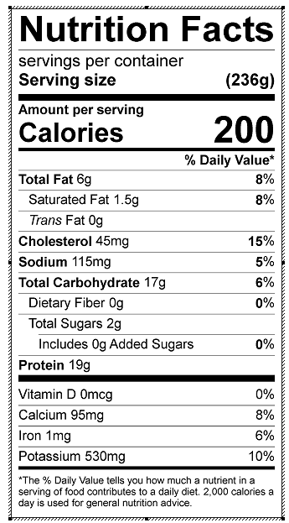
Healthy Potato, Braised Greens, & Chicken Bake with High Protein Cheese Sauce
A healthy mix of potatoes, braised greens and chicken topped with a high protein cheese sauce. This recipe is high in protein and low in sodium and has been developed especially for the healthcare segment.
Featuring: Simply Potatoes® Small Diced Potatoes, 20169-15110-00
Servings: 24 Servings
Directions Heat oil in pan on high heat, add potatoes and chicken, shaking to coat in oil. Let sit for a few minutes until browned on one side. Add minced garlic. Shake again every few minutes until all sides are golden brown. Add greens, tossing until coated. Transfer to baking pan. Meanwhile, preheat the oven to 350° F. In the same pan you used to cook the potatoes and chicken, bring the broth and ½ of the milk to a low boil. Once boiling, turn to low to simmer. In a bowl, whisk remaining milk and flour. You may need to add a bit more flour to achieve thick paste consistency. Add mixture to the broth, whisking to keep smooth. Add Greek yogurt and 2/3 of the cheese. Stir until melted. Pour sauce over the potatoes, greens and chicken in the baking dish. Toss to coat, then sprinkle with remaining cheese. Bake for 40 minutes, or until sauce is bubbly and cheese has browned.
Ingredients
Olive Oil | 4 Tbs
Simply Potatoes® Small Diced Potatoes, 20169-15110-00 | 6 cups
Skinless raw Chicken Breast, diced | 3 lbs.
Garlic, minced | 6 Tbs
Favorite Greens, (Kale, Spinach, etc.) chopped small | 10 cups
Low Sodium Chicken Broth | 6 cups
Skim milk | 2 & ¼ cup
Flour, AP | ¾ cup
Swiss Cheese, shredded | ¾ cup
Greek yogurt, low fat | 1 & ½ cup

